Slide 1
Automatic offside detection
Rupesh AK 312216104088
Vibhuti Kushwaha 312216104120
Prashant Kumar Dixit 312216104078
Guide: Dr. K.Lekshmi, Associate Professor
SSN College of Engineering, Chennai
20 Septempter,2020

Slide 2
Abstract
Offside detection - one of the most important decision - average of 15 offside decisions every game.
False detection and rash calls drastically change the outcome of the game.
Human eye - finite precision.
Current offside decisions - manually by sideline referees - controversial in many games.
This calls for automated offside detection techniques in order to assist accurate refereeing.

Slide 3
h
Judgment errors : Deciding games
This study proposes a technique of football-offside detection using a camera.
A static camera –hooked up as a hardware device – offside alert
The vertical lines(imaginary) that constitute the attackers, defenders and ball are used as their positions for logically judging the offside.

Slide 4
Problem Statement
Offside decisions are one of the most controversial decisions in the game of football.
It is currently handled by human referees. Being handled by humans makes the process instantaneous but is prone to a lot of false decisions.
Football being a game of very close margins makes the decisions very more important and relevant to a game.
Hence the project demands to create an automated system capable of making correct offside decisions in negligible amount of time.
INPUT: A user given video clip.
OUTPUT: Offside offence will be detected.

Slide 5
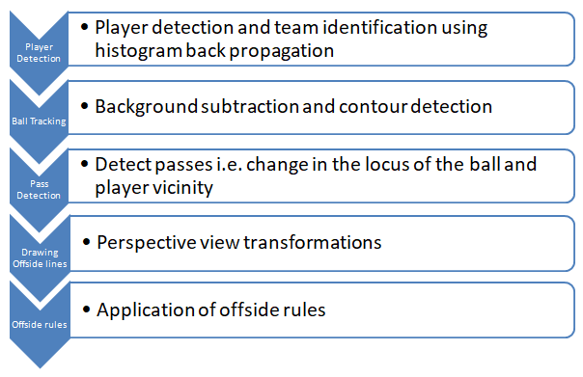
Proposed System

Slide 6
Player detection
1. Histogram back propagation
Back Projection is a way of recording how well the pixels of a given image fit the distribution of pixels in a histogram model. To put it in simpler terms:For Back Projection, the histogram model of a feature is calculated and then used to find this feature in an image.
It helps us differentiate the two teams as, it identifies the part of the images based on color.
The histogram is constructed from the patch of the player(Region of Interest) from team A and team B separately. Now the frame is checked and only areas with similar colour distribution as the patch are selected

Slide 7
Ball Tracking
1. Background subtraction
Every frame of a video can be divided into two different areas: foreground, which groups pixels that are part of the objects of interest (in this case, players of different teams and ball) and background, which groups all pixels that are not part of an object of interest, such as field, sky, stands etc.
We used MOG2(Mixture of Gaussian) method as it is the most recent, and gives better performance rate and is more precise compared to other methods to separate foreground and background.

Slide 8
Ball tracking(cntd)
2. Contour Detection
The idea of contour tracking, also known as boundary following or edge tracking, is to traverse the border of a region completely and without repetition .
The result of the contour tracking is to obtain a boundary points sequence.
Contour tracking is through the order to find out the boundary of the edge points to track. The key of the contour tracking is to judge the next boundary point according to the adjacent points in binary image.
Opencv offers cvFindContours function to realize contour tracking, which retrives contour from the binary image, and return the number of the detected contour.

Slide 9
Background Subtraction
Foreground(i.e. players and the balls
Applying masks to ignore players in the background
Probable regions containing the ball
Contour Detection
Separated regions
Finding contour with largest area to remove possible errors
Single Region
Ball position
Ball segmentation diagram

Slide 10
Pass Detection
The program we wrote has specifically assigned variables for the direction of the ball.
If the deflection in the locus of the ball is more than a threshold value of the angle, it is considered as the beginning of a new pass.
The next step is to check the vicinity of the ball to detect the passer and the receiver.

Slide 11
Drawing offside lines
When seen from a point, the view is called a perspective view.
To draw an offside line, perspective view and its inverse
Transformations were required to achieve the desired lines.
1. Finding corner points
1.1 Finding Line equations
Firstly, slope of each edge is found out as: m = (y2 - y1)/(x2 - x1)
Equation of a line: y - y1 = m(x - x1)
Representing the equation in the form of ”ax + by = c”, we get,
a =m, b = -1, c = mx1 –y1
Now it is clear that any line can be represented in the form of ax + by = c, given any two points on the line.

Slide 12

Drawing offside lines(continued)
1.2 Solving to find corner points
Given two line equations l₁ and l₂, represented by three values a₁, b₁, c₁ and a₂, b₂, c₂ respectively, the intersection point can be found out as follows.
The two equations can be written in the form of matrix as:
(or)AX=C

Slide 13
Multiplying by A⁻¹ both sides we get A⁻¹AX=A⁻¹C which implies,
X =A⁻¹C X
gives the values of x and y give the intersection point.
2. cv2.getPerspectiveTransform(src,dst)
is used to get the homography matrix, M.
3. Inverse of M is calculated using np.linalg.inv() function.
4.Using these two matrices respectively players positions are transformed to apply rules and transform them back to perspective view to draw offside line with respect to the last defender.

Slide 14
Offside rule Application
An offside offence can occur when someone passes the ball to someone of his own team.
Thus we only check for the offside conditions when a pass is detected and the passer and the receiver belong to the same team, i.e. attacking team.
The steps are:
If both passing and receiving teams are attacking teams, check next conditions. Else mark onside.
If X position(Offender_{i}) ≤ X position(Offside) ≤ X position(Offender_{j}), where Offender_{i} and Offender_{j} are passers and receivers respectively of the attacking team, then it is an offside offence.

Slide 15
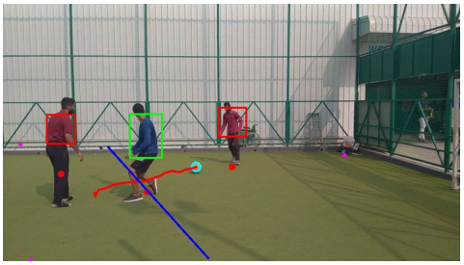
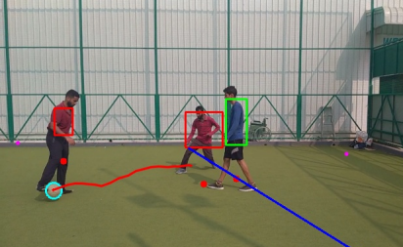
Offside offence
Onside

Slide 16
Conclusion
Given a static camera view + input patches - track the players and the ball and accordingly decides if an off side offence or not.
Histogram Back Projection to track players + differentiate their teams. Uses histograms to match the sample image onto the target image to find areas with the same color patterns.
Background subtraction to bring out the regions of interest in the given frames, followed contour detection, color based masks and noise filtering helped tracking the ball.
Concept of Homographic transformations was applied to achieve the top view from the perspective view and vice-versa.
Lastly, we discovered the answer of the most basic question of the students in schools i.e. “Why do we need to study this in Mathematics?”.

Slide 17
Future Work
Multiple cameras – Better accuracy
Occlusion removal
Algorithms independent of the colors to detect players and ball may improve the efficiency.

Slide 18
References
Marcomini, L.A. and Cunha, A.L.. (2018) ‘A Comparison between Background Modelling Methods for Vehicle Segmentation in Highway Traffic Videos.’ .
Shanpreet, Kaur (2017) ‘Background Subtraction in Video Surveillance’, University of Windsor.
Sahasri, M., and Gireesh, C.. (2017) ‘Object Motion Detection and Tracking for Video Surveillance’, International Journal of Engineering Trends and Technology (IJETT) .
Shopa, P,Sumitha, N., and Patra, P.S.K.. (2014) ‘Traffic Sign Detection and Recognition Using OpenCV’, ICICES2014 - S.A.Engineering College, Chennai, Tamil Nadu, India.

Slide 19
References
Chetan, Sai, Tukita ,Charan, Vallapaeni, Karthikeyan, B.. (2018) ‘Image Handling and Processing for Efficient Parking Space Detection and Navigation Aid’ ,VIT University,India.
Akshata, Bhat, Pranali, Narkar,Divya,Shetty and Ditixa,Vyax. (2018) ‘Detection of Potholes using Image Processing Techniques’ In IOSR Journal of Engineering (IOSRJEN),ISSN (e): 2250-3021, ISSN (p): 2278-8719 ,Volume 2, PP 52-56.
Karthik, Muthuraman, Pranav,Joshi and Suraj,Kiran,Raman. (2018) ‘Vision Based Dynamic Offside Line Marker for Soccer Games’ .

Slide 20
References
Pratik,N.,Patil, Rebecca,J.,Salve,Karanjit,R.,Pawar and Atre,M.,P. . (2018) ‘Offside Detection in the Game of Football Using Contour Mapping’ In 48 49 International Journal of Research in Engineering and Science (IJRES) ISSN (Online): 2320-9364, ISSN (Print): 2320-9356 Volume 6 Issue 4 ,Ver. II ,PP. 66-69

